Slide 1
FINAL COURSE PROJECT
CEIS114 IOT Traffic Control
PRESENTED BY JACOB DYNES

Slide 2
Contents
MODULE 1: Inventory of parts
MODULE 2: Plan for IoT Traffic Controller
MODULE 3: Creating the Traffic Controller
MODULE 4: Creating a Multiple Traffic Light Controller
MODULE 5: Creating a Multiple Traffic Light Controller with a Cross Walk
MODULE 6: Creating a Multiple Traffic Light Controller with a Cross Walk and an Emergency Buzzer
MODULE 7: Screenshots of helpful advice to other students

Slide 3



CEIS 114
Module 2
Project Plan for IoT Traffic Controller

Slide 4
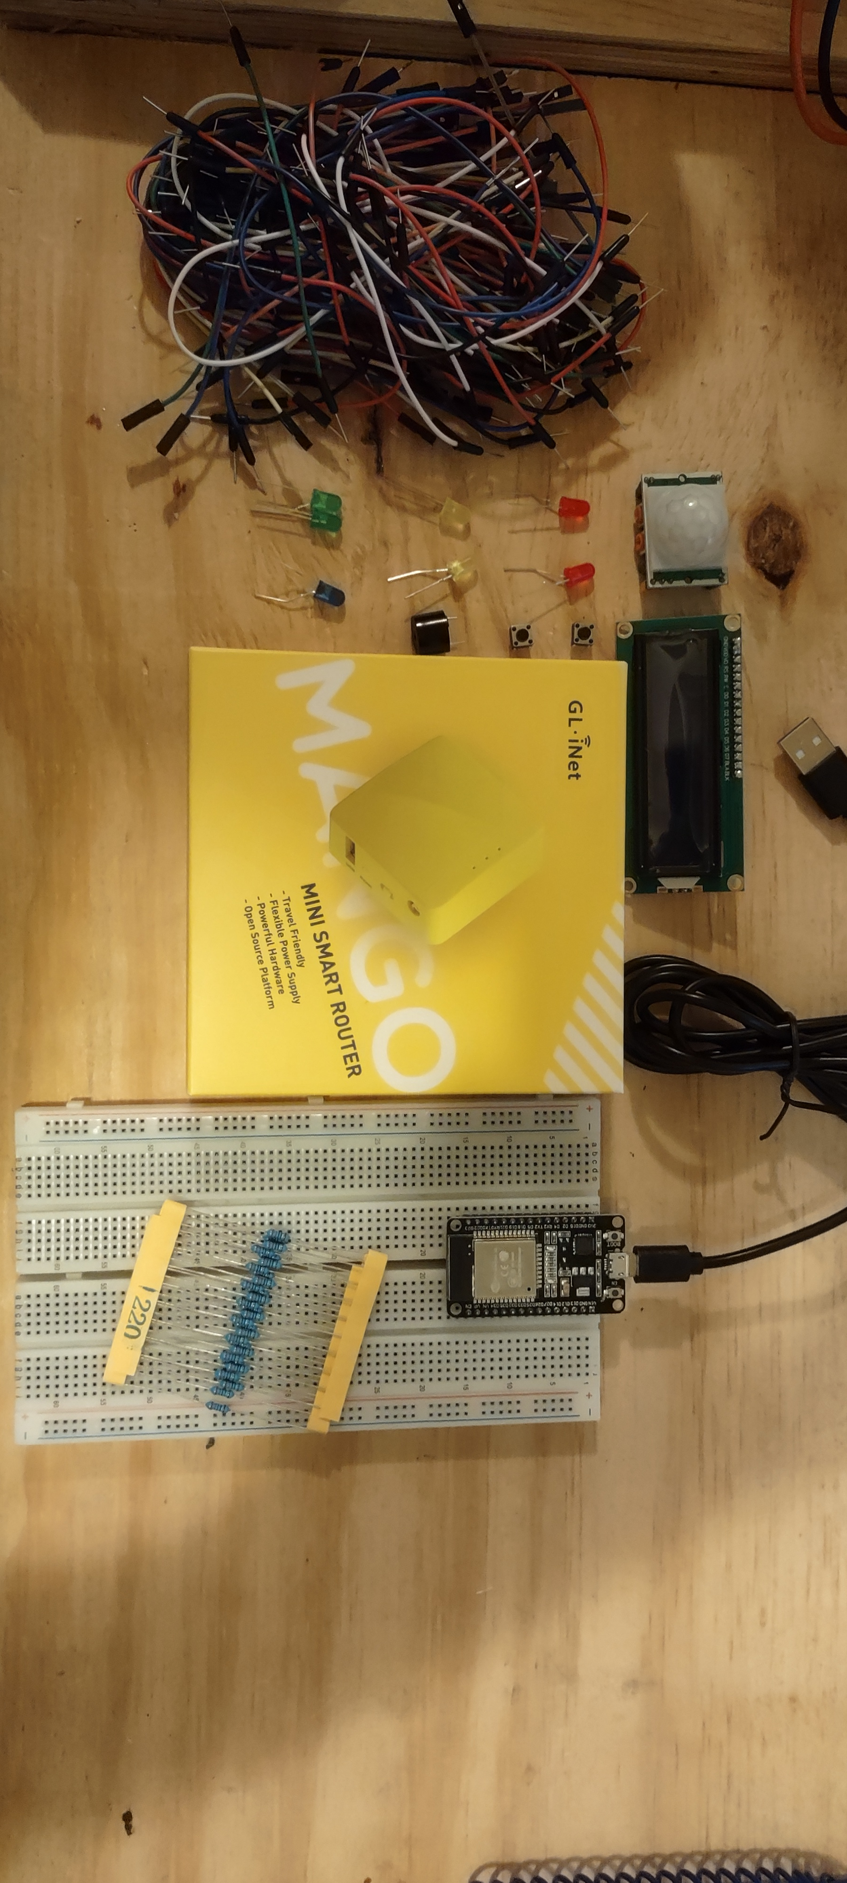
Inventory (Picture)
ESP 32 Board
Colored LEDs: Red, Yellow, Green, and Blue
220 Ohm Resistors (optional)
Wires
Breadboard(s)
LCD Unit with I2C Adapter
Active Buzzer
Mini Router
Push Button(s)
PIR Motion Sensor

Slide 5
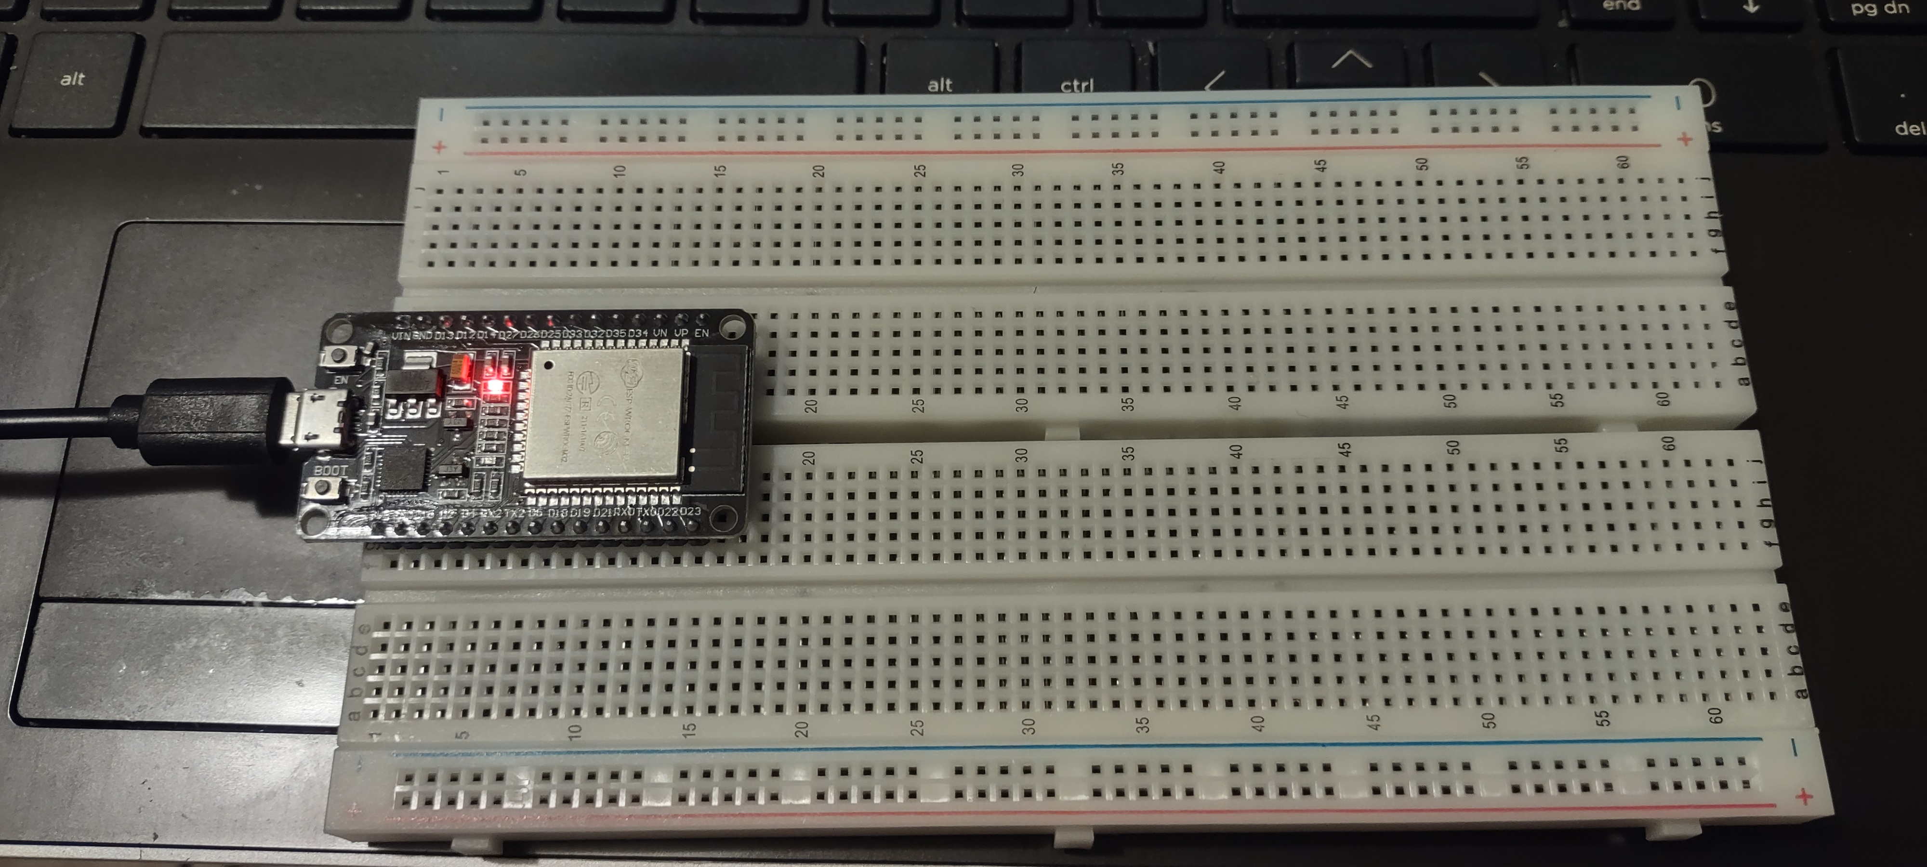
ESP32
Microcontroller mounted and powered ON

Slide 6
CEIS 114
Module 3
Creating the Traffic Controller

Slide 7
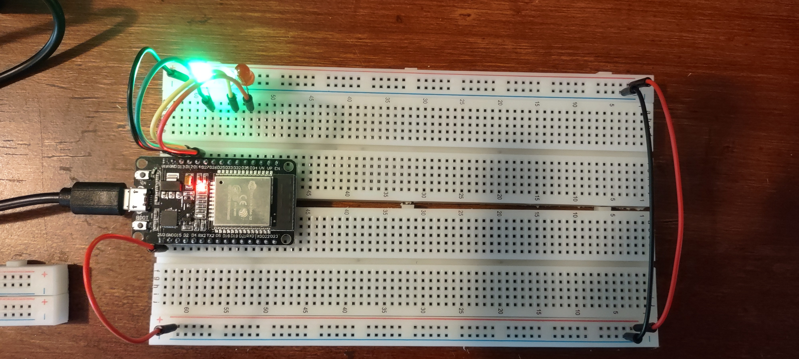
Picture of circuit with working LEDs
ESP 32 Board
Colored LEDs: Red, Yellow and Green
220 Ohm Resistors (optional)
Wires
Breadboard

Slide 8
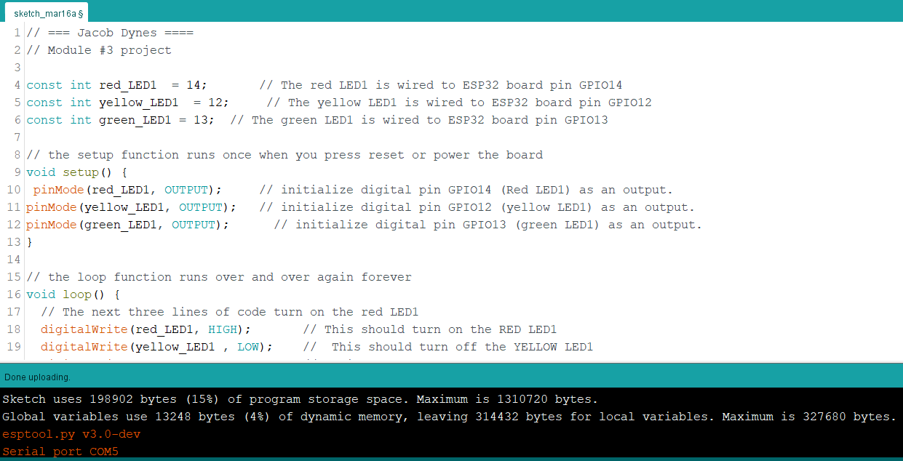
Screenshot of code in Arduino IDE

Slide 9
CEIS 114
Module 4
Creating a Multiple Traffic Light Controller

Slide 10
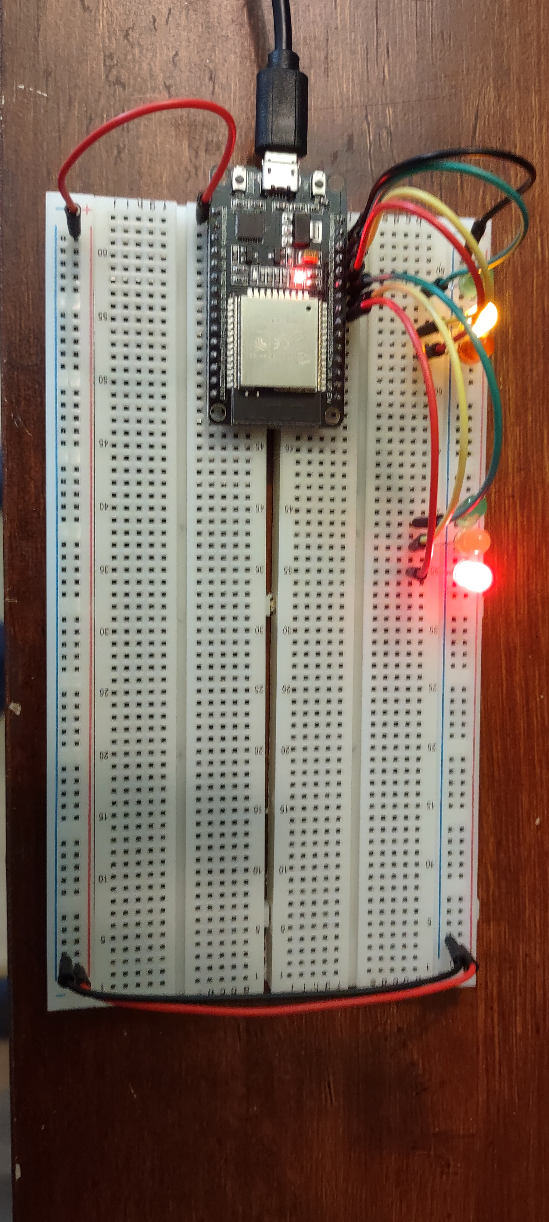
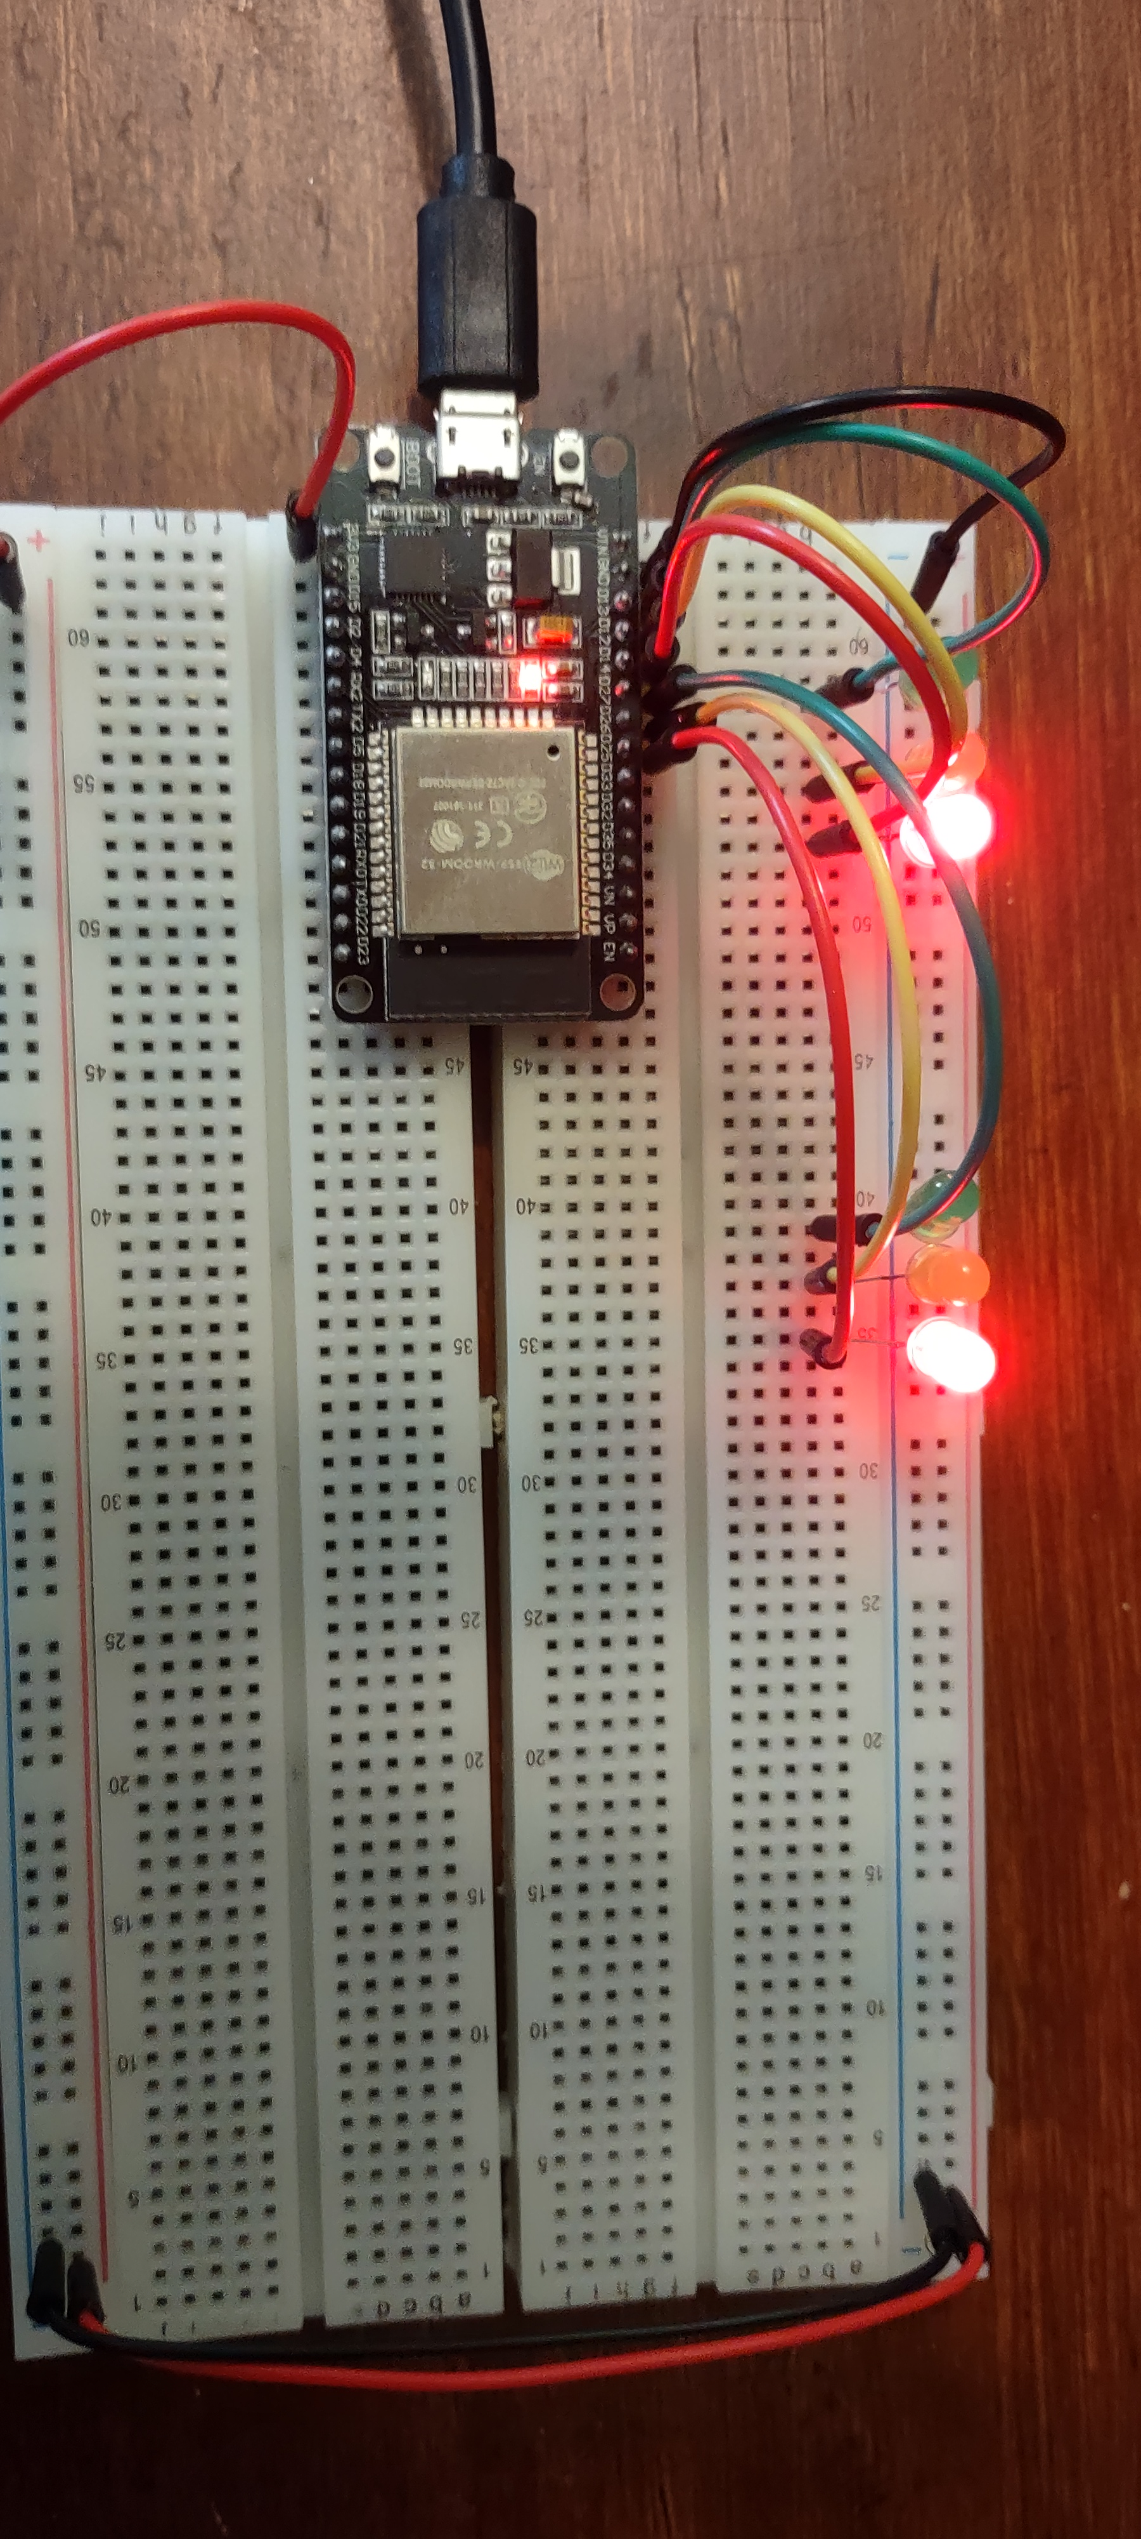
Picture of circuit with working LEDs
ESP 32 Board
Colored LEDs: Red, Yellow and Green (two sets)
220 Ohm Resistors (optional)
Wires
Breadboard

Slide 11
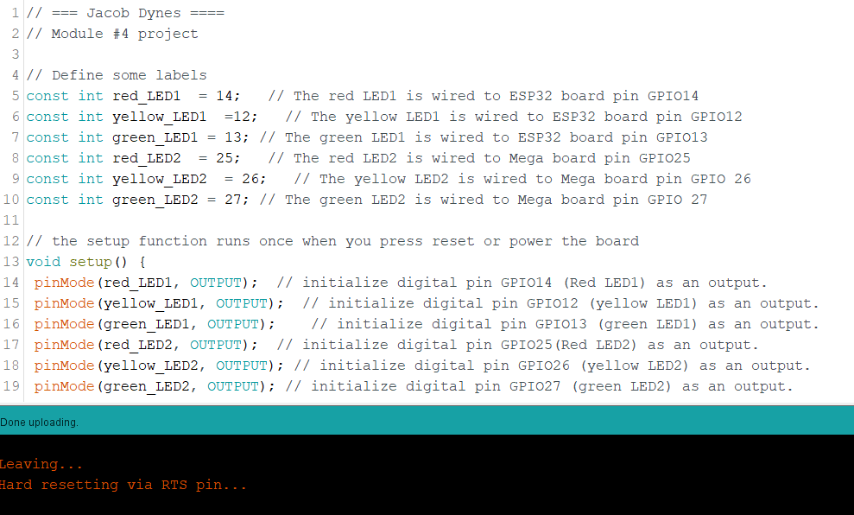
Screenshot of code in Arduino IDE

Slide 12
CEIS 114
Module 5
Creating a Multiple Traffic Light Controller with a Cross Walk

Slide 13
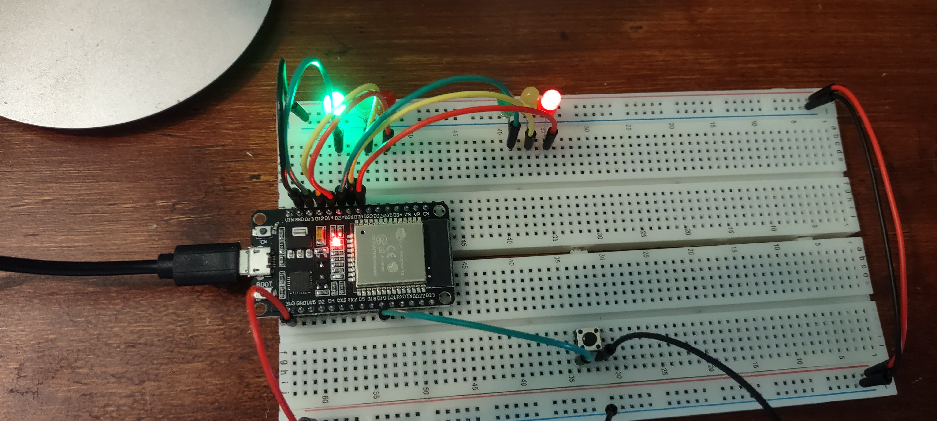
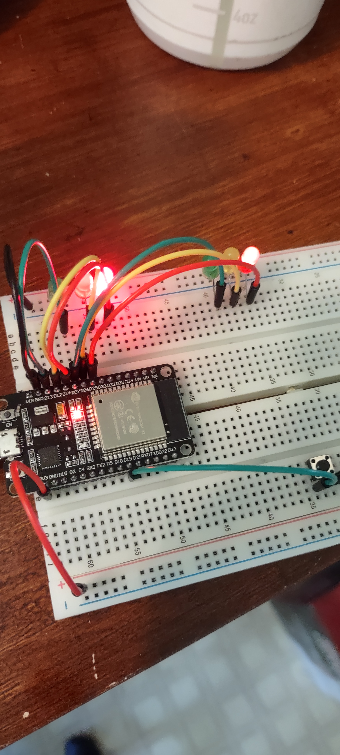
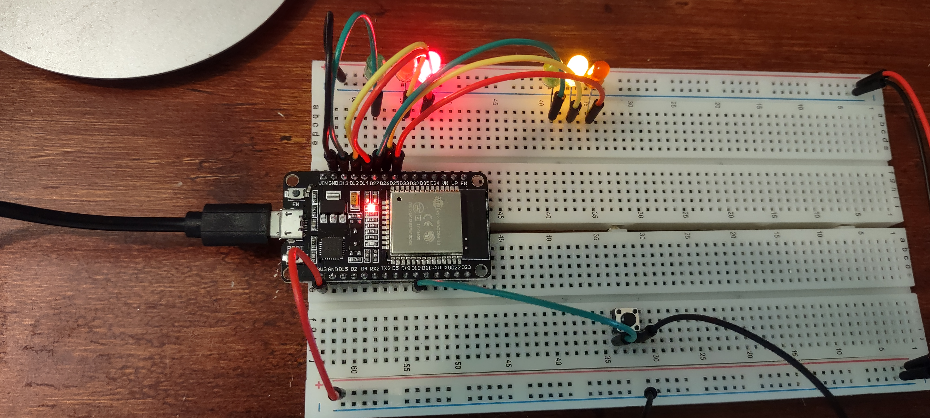
Picture of circuit with working LEDs
ESP 32 Board
Colored LEDs: Red, Yellow and Green (two sets)
220 Ohm Resistors (optional)
Push Button
Wires
Breadboard

Slide 14
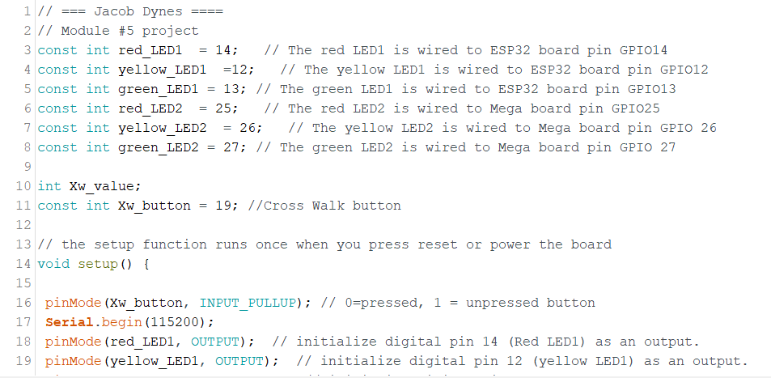
Screenshot of code in Arduino IDE

Slide 15
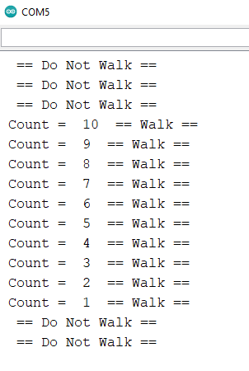
Screenshot of Serial Monitor in Arduino IDE

Slide 16
CEIS 114
Module 6
Creating a Multiple Traffic Light Controller with a Cross Walk and an Emergency Buzzer

Slide 17
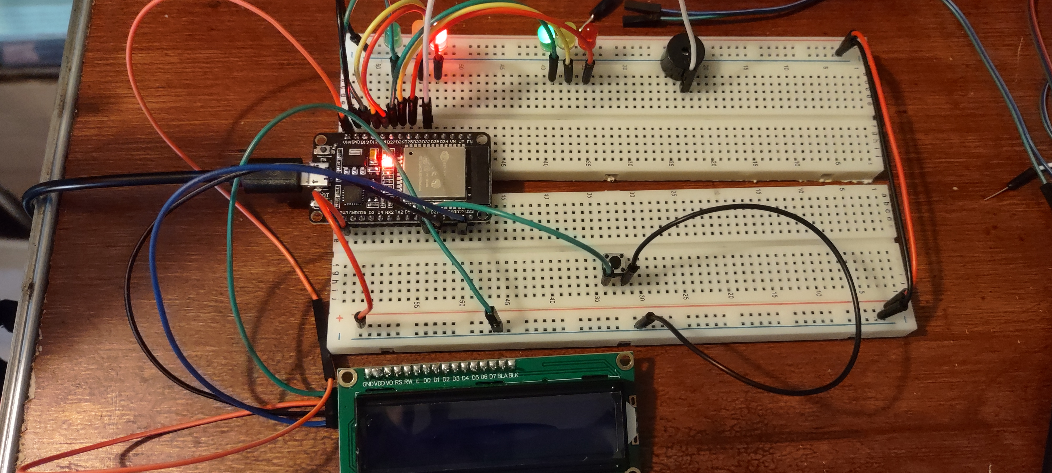
Picture of circuit with working LEDs and LCD display
ESP 32 Board
Colored LEDs: Red, Yellow and Green (two sets)
220 Ohm Resistors (optional)
Push Button
LCD Unit with Message Display
Wires
Breadboard

Slide 18
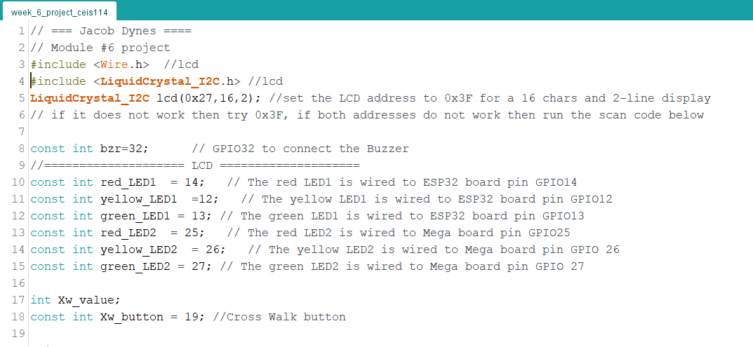
Screenshot of code in Arduino IDE

Slide 19
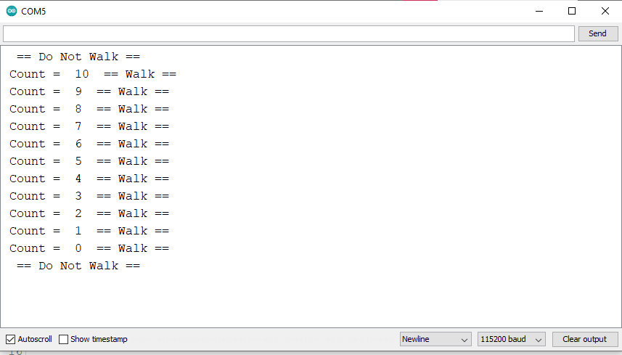
Screenshot of Serial Monitor in Arduino IDE

Slide 20
CEIS114 MODULE 7 Clips Post to Fellow Students

Slide 21
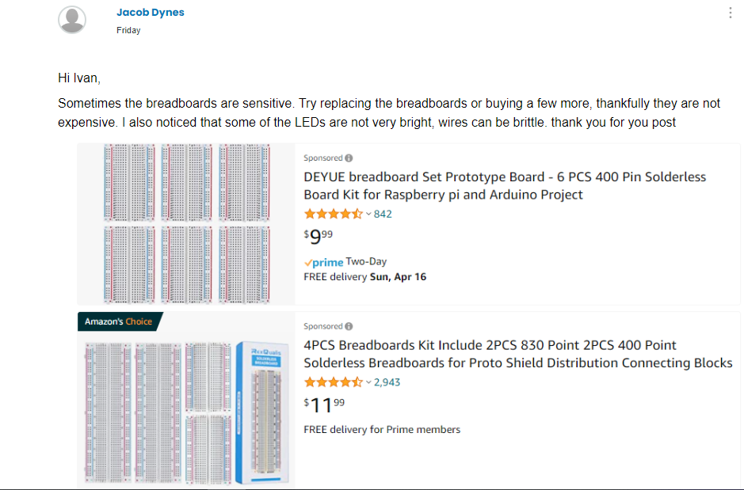
Advice to another student.

Slide 22
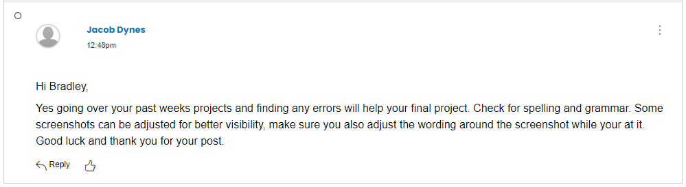
Advice to another student.

Slide 23
Career SKILLS ACQUIRED
Understanding of how a traffic light works.
Getting faster at using PowerPoint.
A better understanding of Arduino IDE.
Troubleshooting Bread Board wiring.

Slide 24
CHALLENGES
Breadboard sensitivity
Wire pins melting
Display board shorting out.

Slide 25
Resources used
YouTube
Project Guides
Post from other Students

Slide 26
Thank you
Email
https://jdynes1.wixsite.com/engineering

