Slide 1
FINAL
NETW191 Course Project
Presented by Jacob Dynes

Slide 2


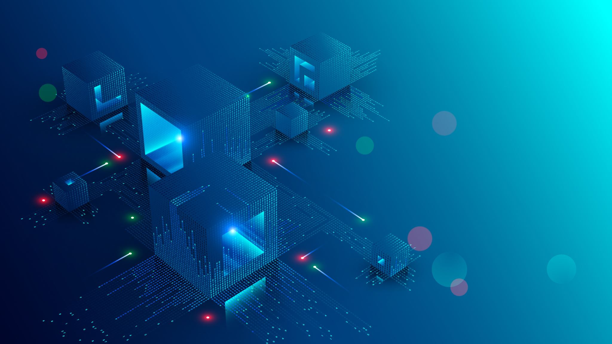
Module 2
Addressing and Protocols

Slide 3
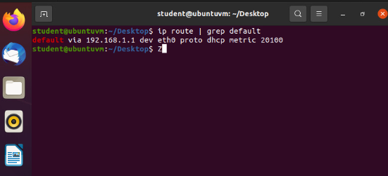
Preparation

Slide 4
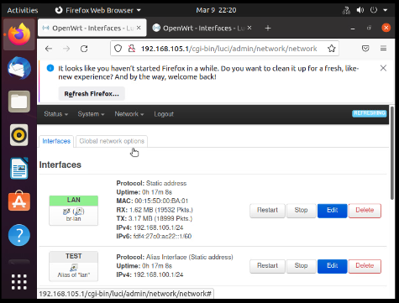
IPv4 Address Assignment

Slide 5
Module 3
Connectivity Test

Slide 6
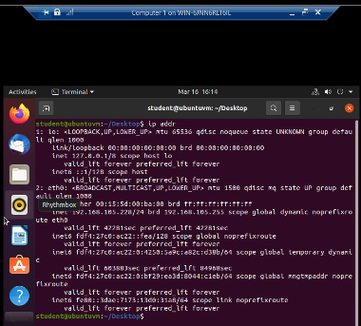
Dynamic IP Address Assignment
Computer 1

Slide 7
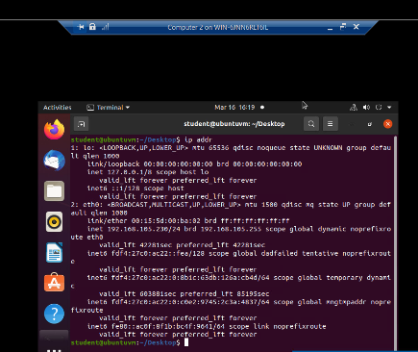
Dynamic IP Address Assignment
Computer 2

Slide 8
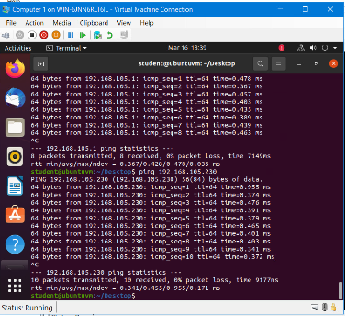
Connectivity Test computer 1

Slide 9
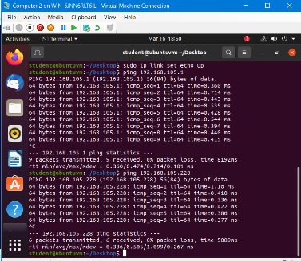
Connectivity Test computer 2

Slide 10
Module 4
IP Subnetting and Loopback Interfaces

Slide 11
Subnetting Table
 | Subnet ID | Network Mask (/prefix) | Network Mask (Dotted decimal) | Network Address | First Usable Host Address | Last Useable Host Address | Broadcast Address
The First Subnet | 0 | /25 | 255.255.255.128 | 192.168.5.0 | 192.168.5.1 | 192.168.5.126 | 192.168.5.127
The Second Subnet | 1 | /25 | 255.255.255.128 | 192.168.5.128 | 192.168.5.129 | 192.168.5.254 | 192.168.5.255

Slide 12
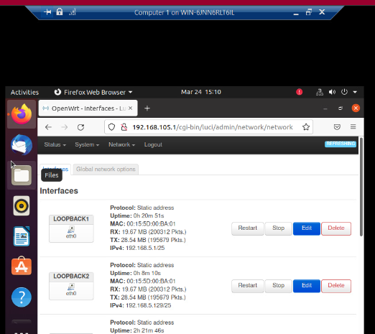
Loopback Interfaces

Slide 13
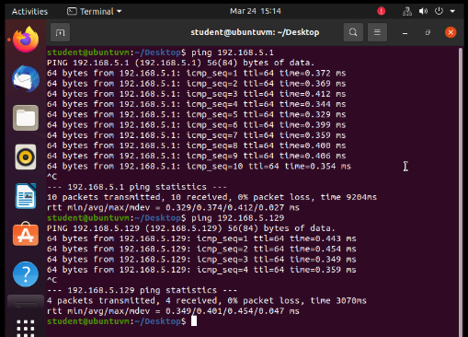
Connectivity Tests
This screenshot should show two successful ping tests from the Computer 1 VM to the Loopback 1 and Loopback 2 interfaces.

Slide 14
Module 5
Visio Network Diagram

Slide 15
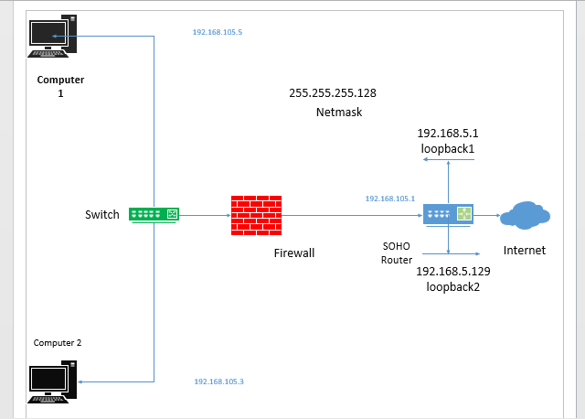
Microsoft Visio Network Diagram

Slide 16
Module 6
SOHO Wireless Network Security

Slide 17
SOHO Wireless Network Security
1. What are the factory default username and password of a TP-Link router? Why is it important to change the default username and password of a SOHO router?
Answer: It is important to change password and user name to improve security and make it harder to hack into.
Default Username - admin
Default Password - admin
2. To protect a SOHO wireless network with a small number of devices, which address management method provides more control, configuring the device IP addresses manually (static IP) or using a DHCP server (dynamic IP)? Why?
Answer: I think that the address management method that provides more control, configuring the device IP address manually is a Static IP addresses because it requires manual configurations and allows network devices to retain the same IP address all the time.
3. What does MAC filtering do? If needed, when would you use deny filtering rules and when would you use allow filtering rules? What happens to devices that want to connect, if the “Allow the stations specified by any enabled entries in the list to access” function is enabled but there are no entries in the list?
Answer: MAC address filtering allows you to block traffic coming from certain known machines or devices. The router uses the MAC address of a computer or device on the network to identify it and block or permit the access. Traffic coming in from a specified MAC address will be filtered depending upon the policy. To deny Type in the MAC address you want to allow or deny to access the router and give a description for this item. The status should be Enabled and at last, click the Save button

Slide 18
SOHO Wireless Network Security
1. What wireless security settings are displayed on the Wireless Security page? Which one is recommended by the vendor? Why?
Answer: For network security, it is strongly recommended to enable wireless security and select WPA2-PSK AES encryption.
AES is recommended by vendor
For encryption, you can select either Auto, or TKIP or AES
Version:
Encryption:
Wireless Password:
Group Key Update Period:
2. Among the configurations you explored in this module, which one is a true security function? Why?
Answer:
Ip masking and encryption. Masking your IP can protect your network from hackers and encryption scrambles the data to where it can't be read unless you have the decryption key.
3. What would you do to protect your wireless network at home? Why?
Answer:I use Norton firewalls and I use a very long password that I change every 3 months. I don’t use the same password for long because it can become vulnerable the longer you use it. I also use my own mini server to encrypt my data. I have seen peoples live ruined because of identity theft of just emptying their bank account and maxing out credit cards.

Slide 19
Challenges
Understanding of Network IP Address Math
Understanding how the SOHO Router works
Learning how Visio works

Slide 20
References and Resources Used
https://emulator.tp-link.com/
1.
2.
YouTube
DeVry tutor
InfoSec
Project Guides

Slide 21
Career skills acquired
Understanding of Network addresses
Linking two computers over a network
A better understanding of Linux IP Networking
Making a Visio Diagram

