Slide 1

Final Course Project
Introduction to Programming
CEIS110 Module 8
Presented by Jacob Dynes

Slide 2
CONTENTS
Module 2
Software Library Installation
Develop Flowchart
Module 3
Code
Execution
Database file
Module 4
Query to retrieve all columns and rows
Query to retrieve lowest and highest temperature
Query to find all Clear days
Module 5
Python code
Retrieve and convert data into CSV format
Temperature and Humidity chart
Module 6
Plot second period temperature and humidity using different graphs

Slide 3

Module 2
Design and Library setup

Slide 4
Flowchart
Include the following processes:
Install python
Download weather data to a database.
Extract weather data from database into a comma separated file with python
Cleanse weather data
Use Excel to manipulate data
Use python data analytics modules to develop graphical models

Slide 5
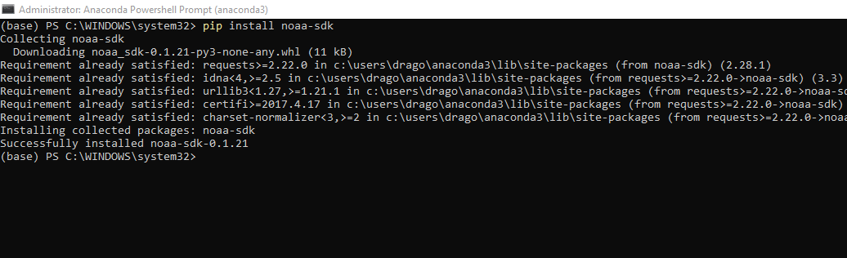
Software Inventory
Included is a screenshot of NOAA-SDK library installed
Results show "Successfully installed noaa-sdk" of pip install command are visible in the screenshot.

Slide 6
Module 3
Downloading weather data

Slide 7
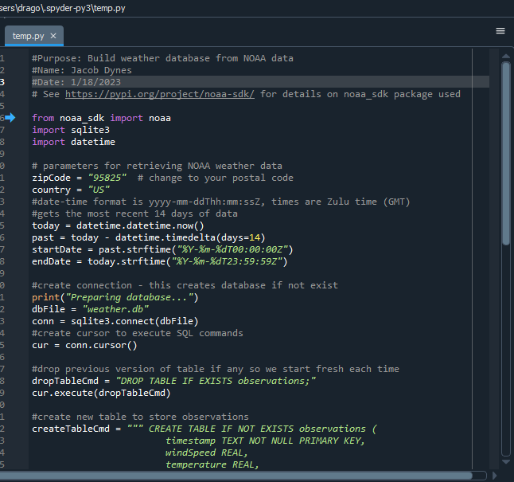
BuildWeatherDb.py Code
Screenshot of code is in Spyder application

Slide 8
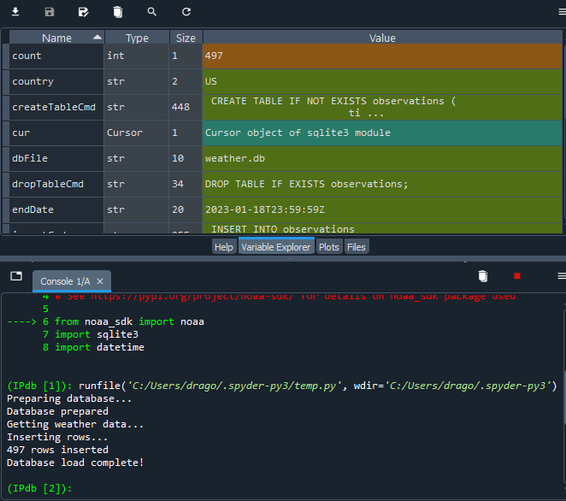
Python Console
Screenshot is of program output in Python console showing program executed successfully

Slide 9
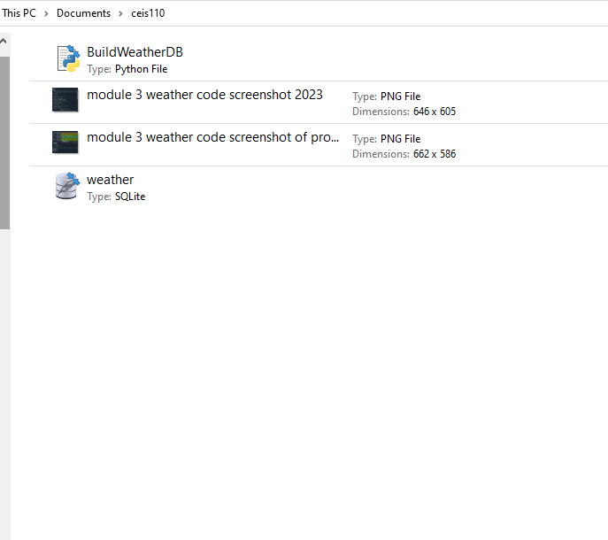
Weather.db File
Screenshot is of Windows Explorer showing database file Weather.db was created

Slide 10
Module 4
Querying the database with SQL

Slide 11
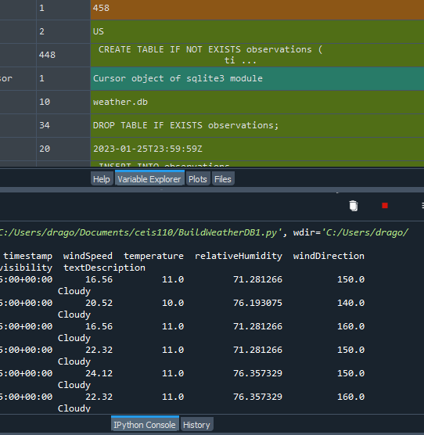
Query to retrieve all columns and all rows
Screenshot is of SQL query command and results

Slide 12
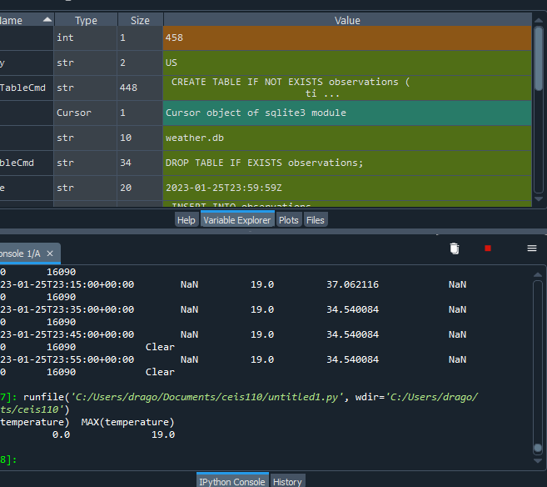
Query to retrieve lowest and highest temperatures
Screenshot is of SQL query command and results

Slide 13
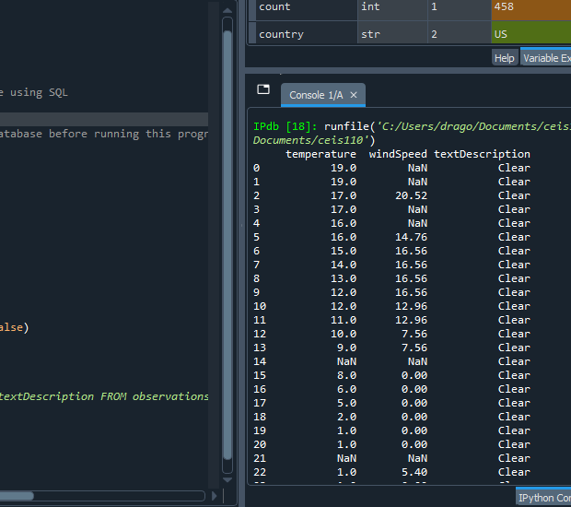
Query to retrieve all clear days
Screenshot is of SQL query command and results

Slide 14
Module 5
Querying and manipulating data with SQL and Python

Slide 15
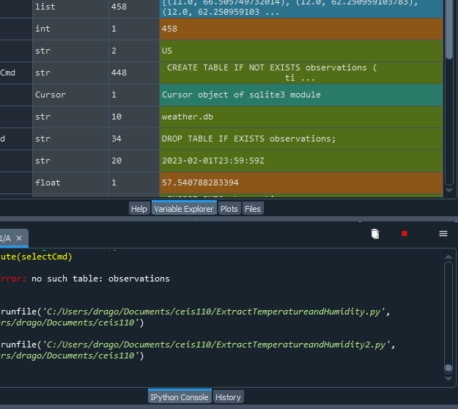
Python code
ExtractTempHumidity.py Python code with your name and date in comments

Slide 16
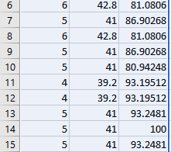
Retrieve and Convert Data to CSV Format
Screenshot shows Format data file open in Excel showing 3 columns of data

Slide 17
Temperature and Humidity Chart
The chart was created in Excel. The chart based on temperature and humidity data from database

Slide 18
Module 6
Develop Graphical Models and Interpret Results

Slide 19
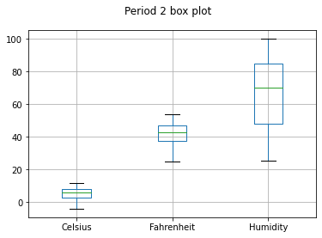
Plot #1
#Purpose: Create box plot for period 2 data
#Name: Jacob Dynes
#Date: 2/9/23
import pandas as pd
import matplotlib.pyplot as plt
df2 = pd.read_csv("formatdata2.csv")
df2.boxplot(); plt.suptitle('Period 2 box plot')
plt.show()

Slide 20
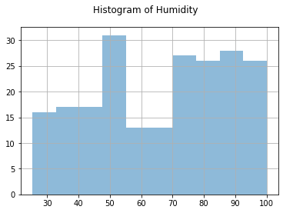
Plot #2
#Purpose: Create a histogram of humidity data from the second period
#Name: Jacob Dynes
#Date: 2/9/23
import pandas as pd
import matplotlib.pyplot as plt
df1 = pd.read_csv("formatdata.csv")
df2 = pd.read_csv("formatdata2.csv")
df2['Humidity'].hist(bins=10, alpha=0.5); plt.suptitle('Histogram of Humidity')
plt.show()

Slide 21
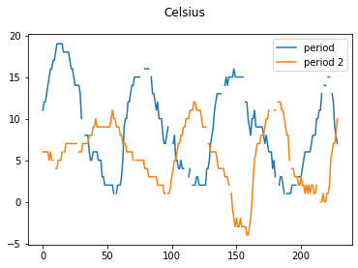

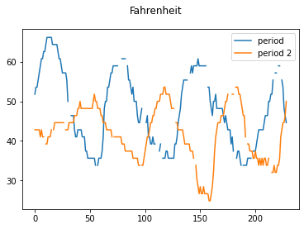
Analysis
Think of your own question and create a chart/graph to answer it
Your own question:
Is the temperature going down over time?
Answer is supported by Chart:
Summer has High temperatures
Fall has lowering temperatures
Winter has colder temperatures
Period one is higher in temperature then period 2 as if it is the changing of the seasons.

Slide 22
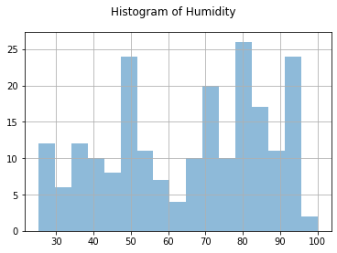
Prediction
Develop a prediction based on the data. What variations in temperature and humidity do you expect over the next few hours or days? How would humidity change if temperature goes up or down?
I think in period 3 humidity will go up just a bit compared to period 2. How ever it does looks like the temperature is going down as time passes based on the current data. Almost like it changing seasons from fall to winter.

Slide 23
Skills I Acquired
Able to understand Python command functions
Able to understand and troubleshoot Python programming errors
Able to read and write some basic Python code
Improved skills in Power Point application
Improved typing skills
Improved skills in Windows Excel
Able to use Spyder Python programming application

Slide 24
Difficulties I had
Being able to retain all the information provided
Typing without misspelling/ mistyping
Understanding what commands to use
Having to focus more intently on the programming to fix any small quotation mistakes

Slide 25
Conclusion
Over the course of this class, I learned how to read and write programming in Python and how complex Python can be.
Looking over the programming was a bit intimidating at first, I had to really try to focus on what meant what, being more precise so that I can narrow down the functions of the Python programming.
As a result, I can now write basic code and understand the functions of the Python program, to which I can’t wait to apply to my robotics.

Slide 26

THANK YOU
Jacob Dynes
Website: jdynes1.wixsite.com/engineering/tech-core-projects

